Slide 1

POWER AND ELECTROMAGNETIC FIELD COMPUTATIONAL ANALYSIS OVER LONGTERM PRE-5G VS 5G EXPOSURE TRENDS
Bachelor’s Degree in Engineering Sciences
Presented by : Vishnu Sai Muppalla
Supervised by : Dr. Luca Chiaraviglio
Notes:
Good morning! Respected dignitaries one and all, myself Vishnu Sai Muppalla here I am to discuss my thesis Power and Emf over longterm pre-5G vs 5G exposure trends. Foremost, I would like to thank my professor Dr. Luca Chiaraviglio for his guidance and support through all stages of my thesis.

Slide 2
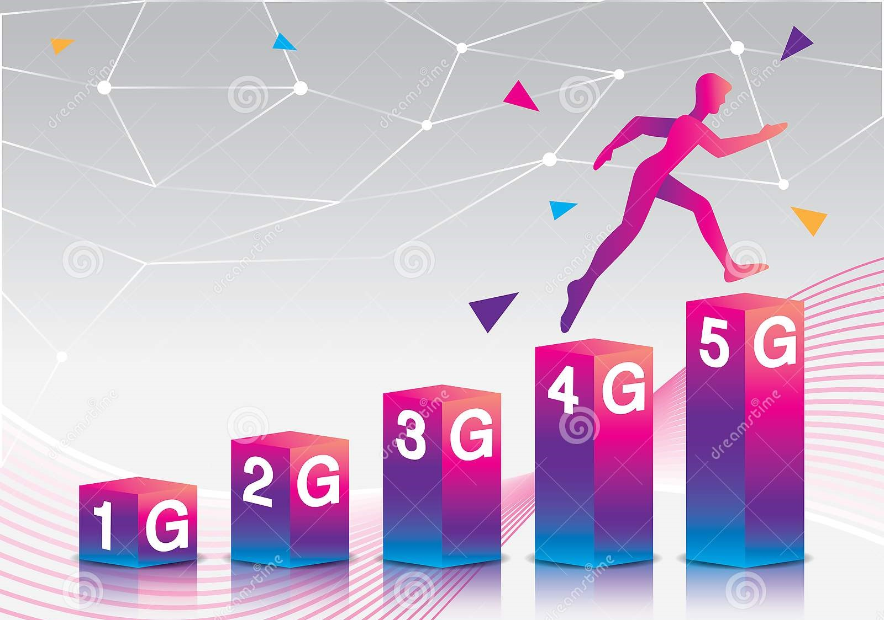
Agenda
Abstract
Evolution of Mobile Networks
5G features & Impact on EMF
Experimental setup
Exposure Analysis
Results
Conclusions
Notes:
In this presn we will be discussing the following sections starting from

Slide 3
Abstract
Our research is focused on dealing with the problem of continuously monitoring the massive long-term 5G exposure and comparing the temporal evolution of 5G exposure against the pre-5G one .
Design, a measuring equipment and measurement parameters for continuous and long-term monitoring over various bands operated by multiple carriers hosted on the site.
Followed by a detailed analysis of massive long-term exposure trends
Investigate different operator wise analysis suggesting a growth of 5G instantaneous Electric field.
Notes:
Our thesis aims at monitoring the evolution of massive 5G exposure over a long period may not only allow us identifying secular trends, but also grasping the evolution of the 5G network itself.
As there are concerns about long-term 5G exposure, mainly because it is believed that Electromagnetic fields emitted by 5G next gen nodes are higher than the existing pre-5G exposure and so that we primarily focused our study on 5g exposure data comparing its temporal evolution to pre-5G ones.
Initially we designed a measuring setup with required parmeters inorder to assess massive long-term exposure over various bands operated by multiple carriers on the base station and their corresponding instantaneous Electric field strength.

Slide 4
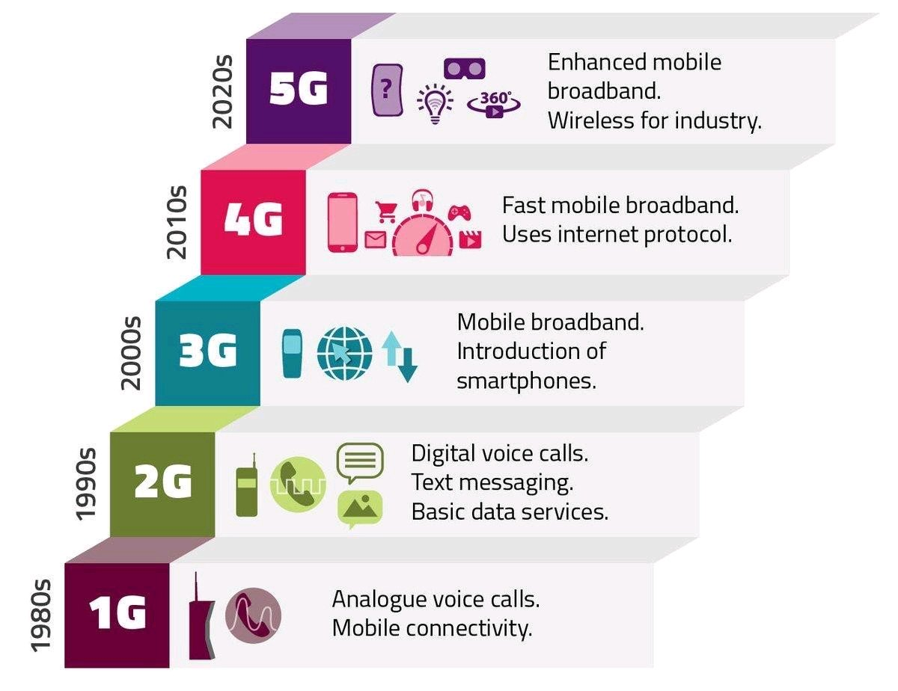
Evolution of Mobile networks
Funding for futurerch
Notes:
The earliest stages of 5G can be tracked to 1980s when 1st generation of wireless technology was introduced which were analog mobile communication standards further replaced by 2G digital standards and their evolution over decades continued in improving until 5G in 2020s where at the moment further research and development work is going on for 6G .

Slide 5
Types of Mobile Networks
ret
First Generation(1G)
Third Generation(3G)
Nordic Mobile Telephone (NMT)
Advanced Mobile Phone System (AMPS)
UMTS or W-CDMA
TD-SCDMA
CDMA-2000
Second Generation(2G)
Fourth Generation(4G)
FDD-LTE(Frequency Division Duplex)
TDD-LTE(Time Division Duplex)
Time Division Multiple Access(TDMA)
Global System for Mobile Communications(GSM)
Notes:
Going in detail, types of mobile networks and their standards that were defined by ITU(International Telecommunication Union)
Starting from pre-5G with first generation mobile networks which were analog telecommunication systems that uses Nmts and Amps standards.
which were later replaced by second generation networks with digital systems based on the Global System for Mobile Communications (GSM), & TDMA standards developed by the European Telecommunications Standards Institute (ETSI) .
Third generation also refers to 3GPP which was an upgrade from 2G,2.5g which was based on standards namely Universal Mobile Telecommunication Standard also called as Wide band code division Multiple access that offer greater spectral efficiency and bandwidth which can also data transfer at high speeds.
Time division synchronous division multiple access is an alternative to w-cdma.
CDMA2000 is a family of 3G mobile technology standards for sending voice and transmitting data between mobile phones and cell site.
Looking to fourth gen of mob network which is also referred to as LTE stands for Long term Evolution with FDDLTE and TDDLTE where both the standards transmit and receive signals based on OFDM and MIMO technologies that offer higher bandwidth speeds and network capacity.
While 4G only uses frequencies below 6 GHz.

Slide 6
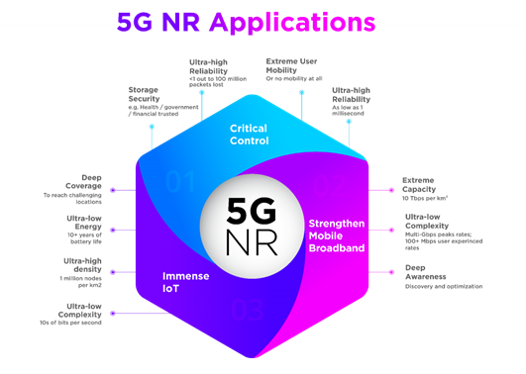
5G Features and Impact on EMF
FR 1
FR 2
Non-Standalone Mode
Low latency connectivity
Beam Forming
Mm Wave
MIMO, MEC, Softwarization
Notes:
On the other hand, focusing on
The fifth Generation(5G) which is the next generation of radio systems and network architecture that delivers extreme broadband, ultra-robust, low latency connectivity, and massive networking for the Internet of things features, which is evident from the presented figure.
NR (New Radio) supports two bandwidths: Frequency Range 1 (FR1), commonly referred to as sub-6 GHz, which ranges from 450 MHz to 7125 GHz, and Frequency Range 2 (FR2), commonly referred to as millimetre wave, which ranges from 24 GHz to up to 50 GHz. Where the maximum bandwidth in FR1 is in the range of 100 MHz, while the maximum bandwidth in FR2 is 400 MHz.
The initial launch of 5G NR technology was built on existing 4G LTE infrastructure in Non-standalone (NSA) Which implies 5G NR deployment relies on the control plane of an existing 4G LTE network for control functions before standalone (SA) matures with a 5G core network.
The influence of 5G technologies on EMF levels remains unclear, despite numerous dedicated studies 5G will be characterized by a set of radical new technologies:
To discuss few of them:
1)Beam forming which enables spatially selective communication resulting in reduction of EMF exposure levels.
2) Use of millimeter wave bands for directional communications in 5G networks as they are characterized by higher path losses.
3) MEC(which is used in decreasing in amount of data trf in the air thus resulting in the reduction of radiated power), MIMO uses different antennas which is highly dependent on the configurations we adopted, Softawrization(by sharing hardware structure within the operators.

Slide 7
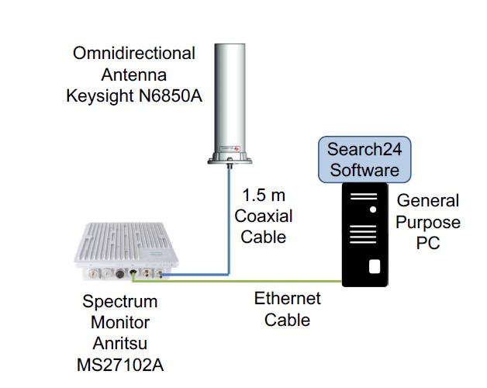
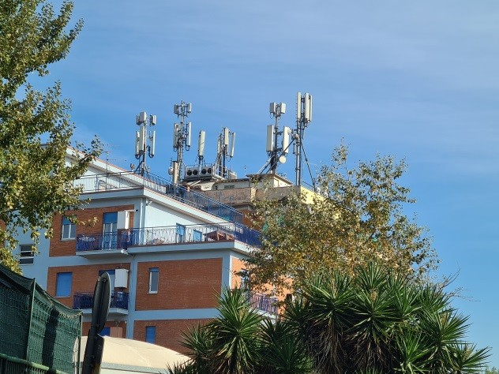
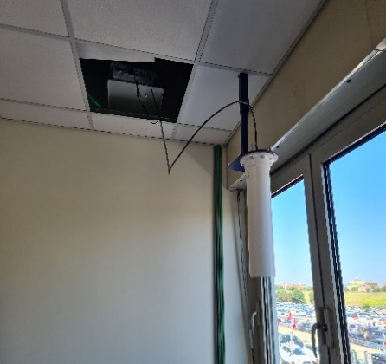
Experimental Setup
Hardware Tools
Software
Base station and Measurement Location
Search 24
Patented ARPA Lazio APP
Site hosting multiple operator in the proximity of University location
Anritsu Remote Spectrum Monitor MS27102A
Passive Omnidirectional
Antenna Keysight N6850A
Matlab to study the behaviour.
Measurement setup at the University Hospital
Notes:
Our long-term measurement activity includes a blend of both Hardware and Software tools
where coming to hardware tools we exploited Anritsu Remote Spectrum monitor which is a full-featured platform that enables continuous real-time monitoring of the radio spectrum in the frequency range 9KHZ-6GHZ .
Here We prefer to use an Passive Omnidirectional antenna, capable of covering all the frequencies up to mid-5G as they are typically characterized by low gain values .
Looking in to software we exploit search24- a proprietary appl of ARPA Lazio to remotely control non vector spectrum Analyzers, In more detail, the Search24 software synthesizes the measurement algorithms as a sequence of Standard Commands for Programmable Instruments (SCPI), which are exchanged between a general purpose computer running Search24 and the MS27102A unit through a private LAN Ethernet connected in cascade.

Slide 8

Exposure Analysis
Operator | Center Frequency [MHz] | Bandwidth [MHz] | Technology
W3 | 796 | 10 | pre-5G
Tim | 806
Vodafone | 816
Tim | 935
Vodafone | 945
W3 | 955
Iliad | 1835 | 20
W3 | 1850
Vodafone | 1870
W3 | 2120
Tim | 2137.5
Iliad | 2150
Vodafone | 2162.5
W3 | 2585
Iliad | 2635
Vodafone | 2647.5
Tim | 2662.5
W3 | 2680
Linkem | 3468.5
Linkem | 3568.5
Linkem | 3589.5
W3 | 3447.5 |  | 5G
W3 | 3547.5
W3 | 3610
Iliad | 3630
Vodafone | 3680
Tim | 3760
Parameter | Value
RBW[kHz] | 100
VBW[kHz] | 300
Span[MHz] | Bandwidth + 2MHz
Channel Power Range[MHz] | Bandwidth
Trace Detector | RMS
Type Detector | Rolling Avg.
The no.of avg.samples | 200
Sweep points | 501
Tab.II PARAMETERS SETTINGS FOR EACH BAND
Tab.I MID-BAND FREQUENCIES
Notes:
Focusing on the monitored bands, we perform a preliminary scan with a portable spectrum analyzer to identify technologies and frequencies of various operators that are sensed in measurement location. Tab.I reports the outcome of our analysis using a wide set of frequencies that supports pre-5G services. We then set the parameters for each bandwidth, summarized in Tab. II as required by search 24 software.
In more detail, Resolution BandWidth (RBW) and Video BandWidth (VBW) of the monitoring unit are set in accordance to the standardized settings of Guide for measuring and evaluating EMF.

Slide 9
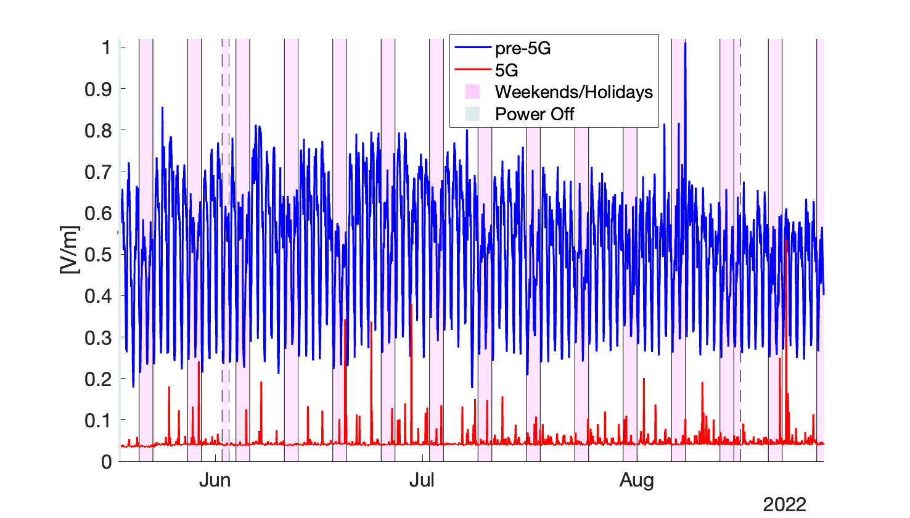
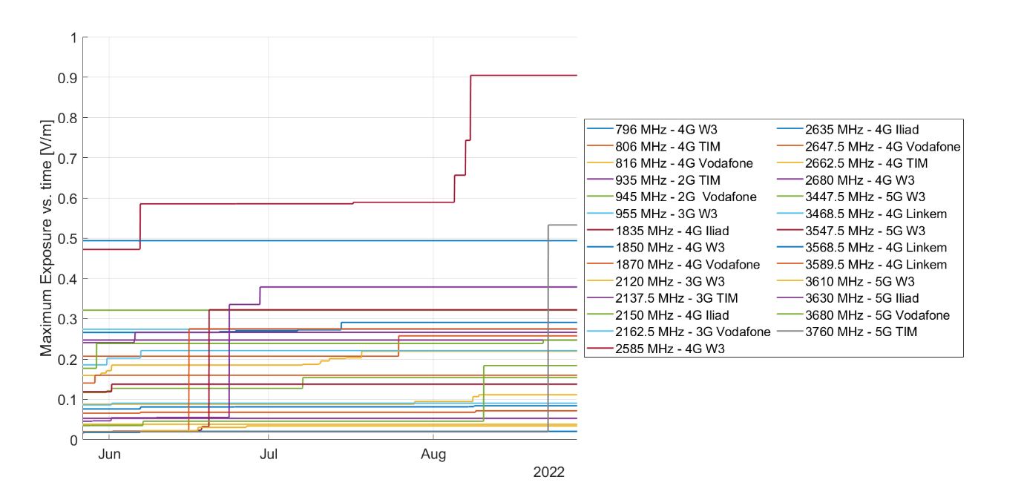
Results
Fig.1:5G and pre-5G exposure vs. time
Fig.2:Maximum exposure vs. time
Notes:
After performing all the measurements through our integrated approach, Coming to the results we initially focused on total 5G exposure vs pre-5G one. From fig.First 5G exposure generally represents a small share with its peaks concentrated occasionally, Later it can be seen that pre-5G exposure exhibits a strong day/night and weekend/weekdays comparatively to 5G ones.
This behaviour is expected, as the exposure is influenced by the no.of conecns active in the covered area.
Maximum exposure vs time for each frequencies of various operators with their frequencies from fig.suggesting that the exposure over 5G technology is increasing. While pre-5G ones exhibits a smoother trend.

Slide 10
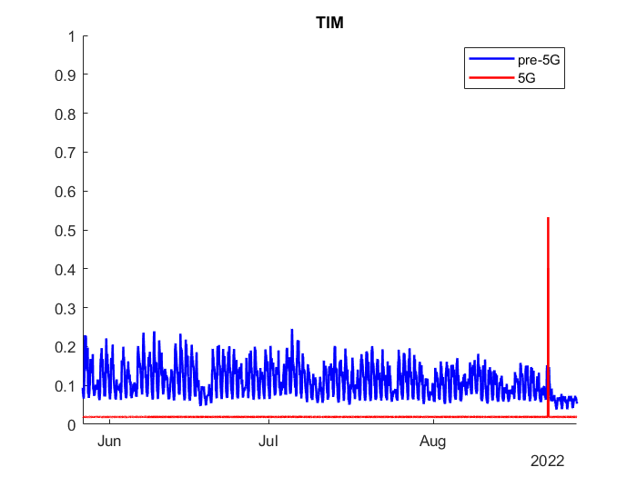
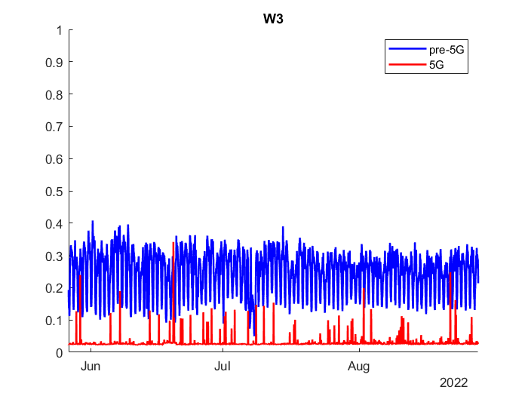
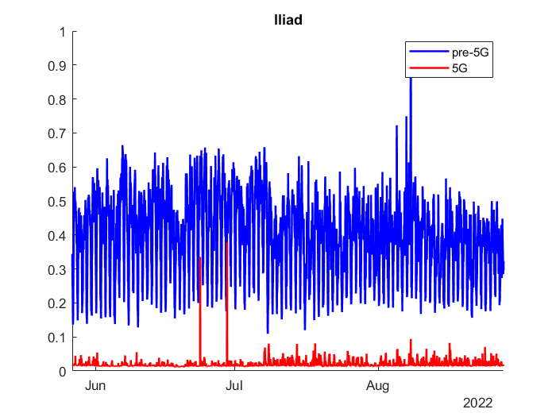
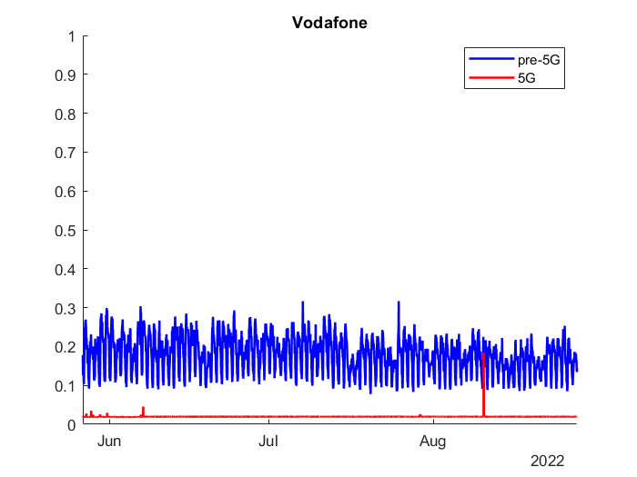
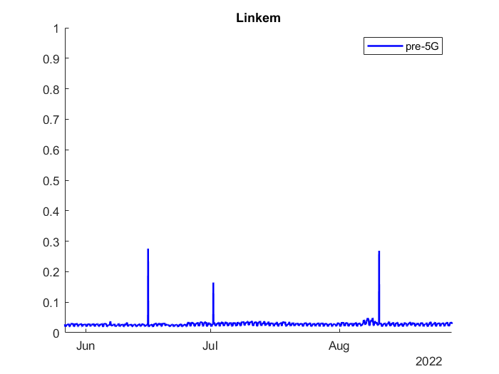
Operator wise
Notes:
The following figures Describes Pre-5G vs 5G exposure operator wise in the given time frame with its corresponding field strength measured in [v/m] it is evident that trend of 5g exposure is flatter and closer to the minimum level compared to the pre-5G one where inkem doesn’t exploit 5G network yet while others are operating 5G although they share a small component which aren’t negligible.

Slide 11
Conclusion
We have initially focused on a three-Month exposure assessment from a location in proximity to Good propagation conditions concerning a base station hosting multiple carriers running both 5G and pre-5G services.
Furthermore, the 5G signals show the largest increase in the maximum exposure vs. time, suggesting that the overall 5G technology growth will be high soon.
In future work, we would like to extract suitable models to predict the future trends of the massive exposure.
Notes:
To conclude with,
We have initially focused on a three-Month exposure assessment from a location in proximity to Good propagation conditions concerning a base station hosting multiple carriers running both 5G and pre-5G services.
From the research and the performance metrics discussed, it is evident that 5G networks are suggesting a growth where our work reveals that, although the share of pre-5G exposure dominates, it can be seen that 5G exposure is not negligible, with 5G peaks that are being noticed both during working days and weekends/holidays.
Furthermore, the 5G signals show the largest increase in the maximum exposure vs. time, suggesting that the overall 5G technology growth will be high soon. In future work, we would like to extract suitable models to predict the future trends of the massive exposure

Slide 12

.
Notes:
Finally, I would like to thank all my professors from Engineering sciences who has been part of this journey. Wishing you all a great day ahead.

Slide 13
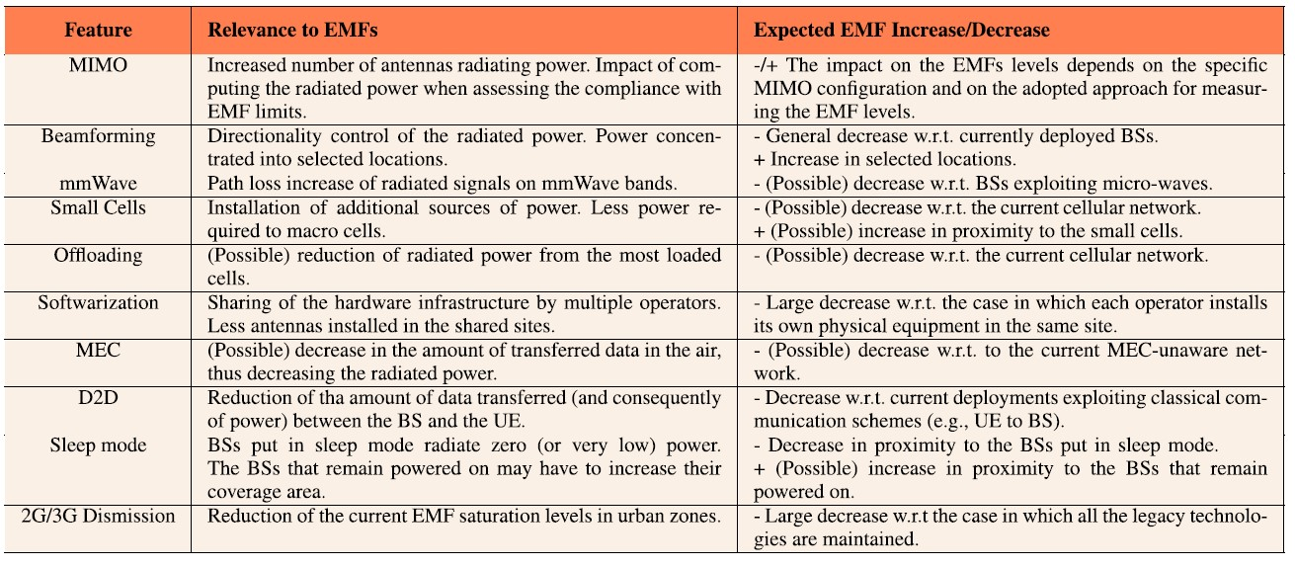
: Influence of the 5G Technology Features on the EMF levels
University of Rome TorVergata
Notes:
Features of 5G technology and their impact on EMF levels.

Slide 14
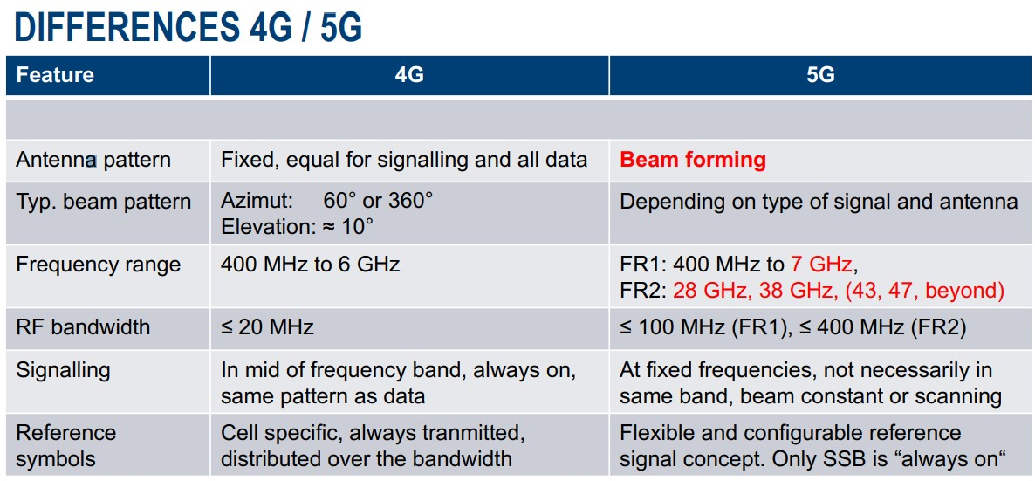

Slide 15
Experimental Activity
In more detail, coming to our experiment by adapting an integrating approach we focus on each band and each hour per day in the considered 3-month period, where we run the following steps to compute the instantaneous Electric field [V/m] for each hour in the time domain
Step 1 Initially, we select samples that come under the current hour from the recorded data,
Step 2 Then we clean the selected data by removing unnecessary and not-correctly measured data such as “NaN” values
Step 3 where an SA setup measures the received power P (dBm) of a signal
Step 4 Conversion of the received power samples from dBm to linear
Step 5 We then compute hourly average power from the samples in the previous step in that specific hour
Step 6 Conversion of the computed hourly time-averaged power, measured during a certain time from linear to dBm,

Slide 16
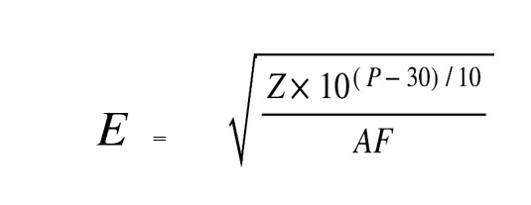
Step 7 Finally We determine the instantaneous hourly Electric field E in V/m.
Step 8 We then perform Operator Analysis specifically to study the pre-5G vs 5G trend behaviour based on day/night, weekend/weekday, and holidays/workdays periodicity.
Focusing on step no:7, the field level E [V/m] is expressed as mentioned formula:
Notes:
With the Knowledge of the input received power to the base station P [dBm], the antenna gain G (direction-dependent) = , the impedance of free space Z = 377[Ω], AF be the antenna factor(dB/m) of the receiving antenna for the central frequency in [Hz] of the current band, wavelength = d/ , and speed of light d = 299792458[m/s].

Slide 17
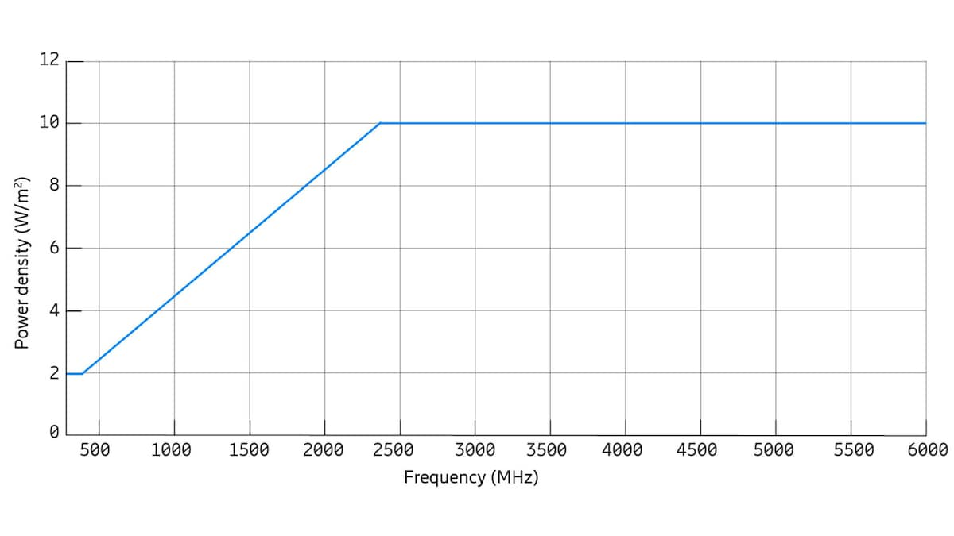
In general, RF-EMF limits applicable to base stations are usually expressed as power density (unit W/m^2) or electric field strength levels (unit V/m). Figure below shows the power density limits for the public that are prescribed in many countries around the world (from the ICNIRP 1998 guidelines). These so-called reference levels are frequency dependent, but from 2 GHz to 300 GHz they are defined at a constant level of 10 W/m^2 (or 61 V/m expressed as electric field strength). Importantly, they are also associated with an average time, such as 6 or 30 minutes, meaning that it is the average power density over the specified time that is to be compared to the limit. Currently, the revision of ICNIRP limits is in progress.

